Slide 1
Online Movie Ticket Booking

Slide 2
Team Members
Employee Id | Name
2527478 | Saranya X
2528028 | Shakti Tiwari
2529211 | Sharmila J
2526827 | Simham Ram Mohan
2529005 | Suba Ganesan
2527998 | Subitsha R
2527424 | Suramanjari G G
2528014 | Swathi S
2529129 | T Sudhir Reddy
2526785 | Thondaladinne Rahul

Slide 3
Introduction
Online Movie Ticket Booking gives the solution to book our tickets by the end user systems.
This project gives real life understanding of online movie ticket booking system and real time market of this industry.

Slide 4
Introduction
NMS Movies is a Full Stack Web Application for booking the movie ticket online. Here admin can add the movies, manage users, manage purchases, update the movie details, delete the movies from the list, set the availability of the movies, set the discount on movie tickets and user can book the tickets, search the tickets, And view there transactions.

Slide 5
Tools and Technologies
Front End: Angular 13/HTML/CSS
Server-Side: Spring Boot
Backend: MySQL , Hibernate
Server: Tomcat
Operating System: Windows 10/11

Slide 6
User Role
Register
Register to the application
Sign In
Sign into the application to maintain the record of activities
Apply
Apply filters and sort results based on different genres
Experience
Experience a seamless payment process.
Receive
Receive a booking summary page once the payment is complete.
Search
Search for movie shows based on the shows currently airing

Slide 7
Admin role
Login to portal
Add/Delete Movies
View and Update Movie Details
Enable or Disable Movie Shows
Manage Users
Manage Purchases

Slide 8
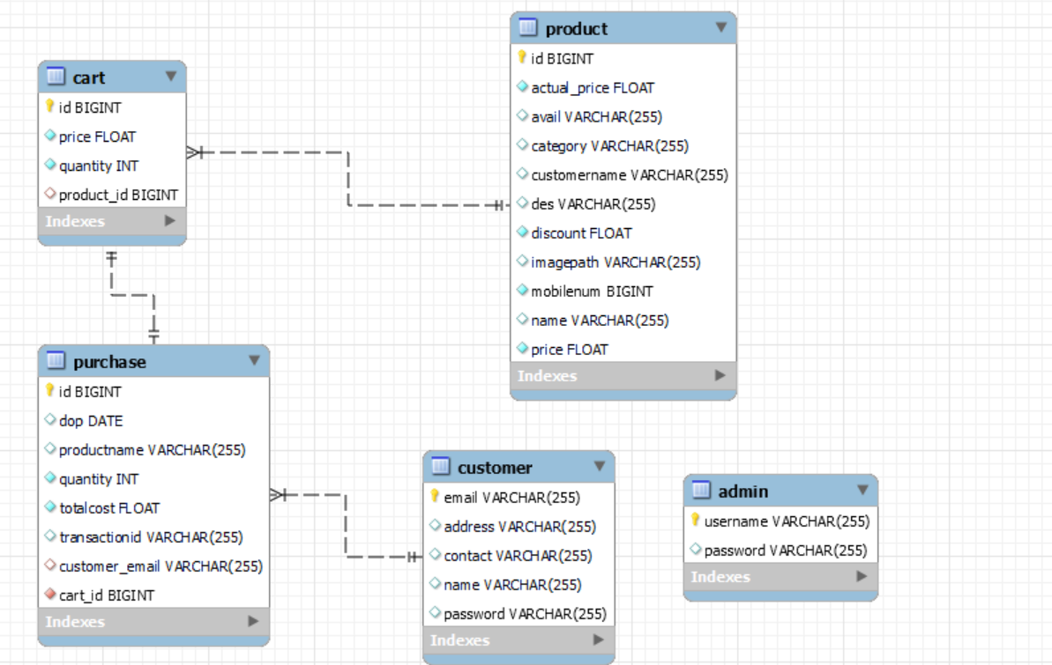
Database Schema

Slide 9
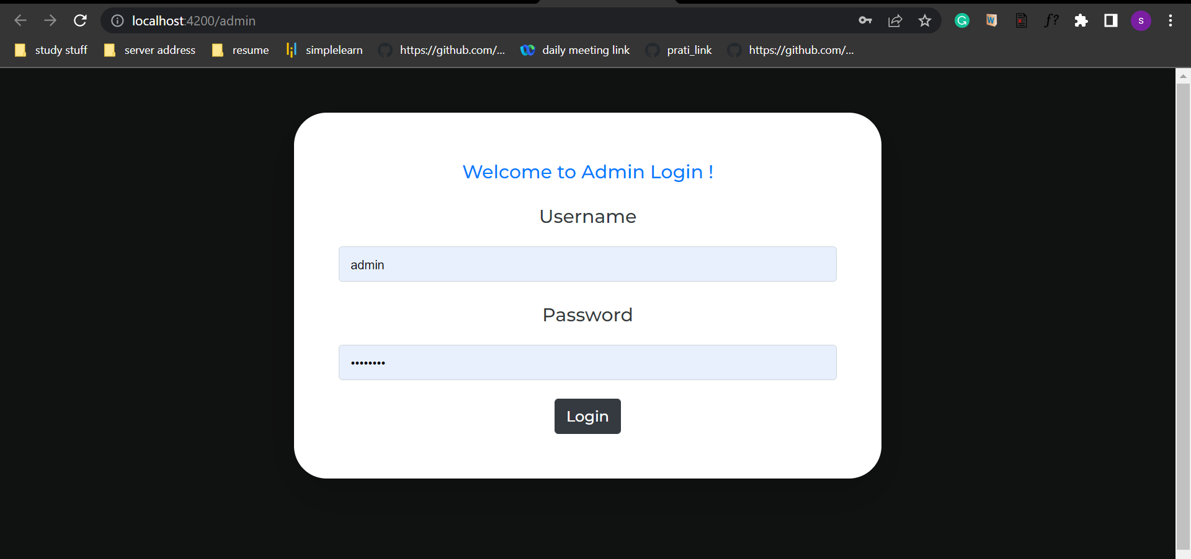
Admin Login

Slide 10
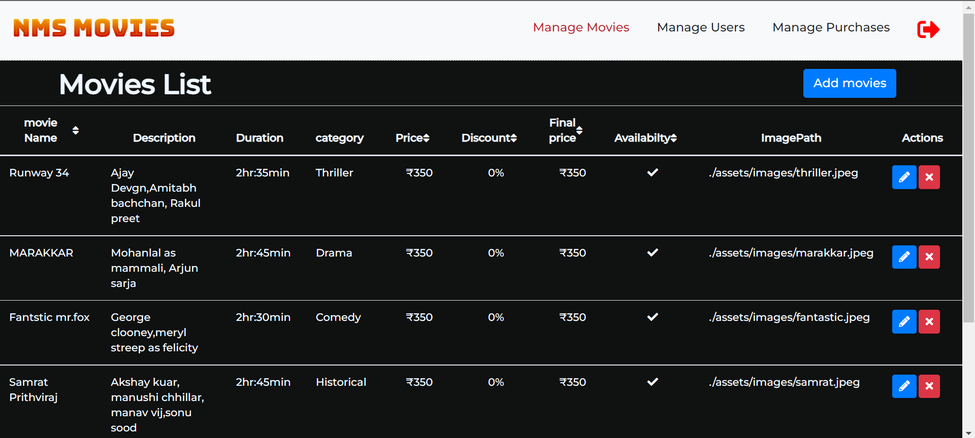
Admin Dashboard

Slide 11
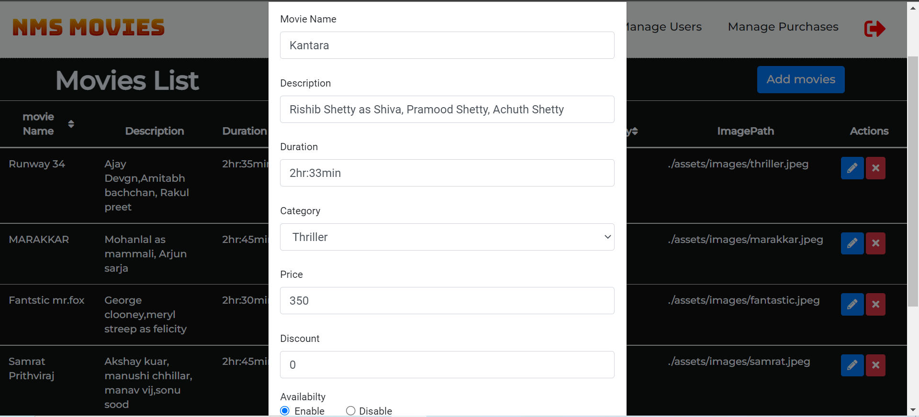

Slide 12
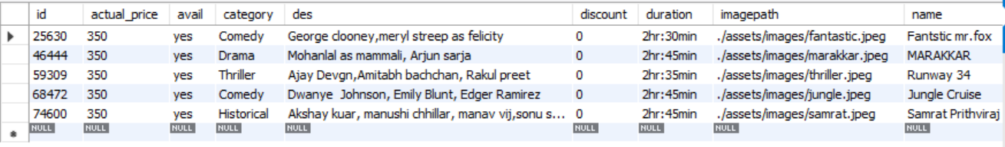
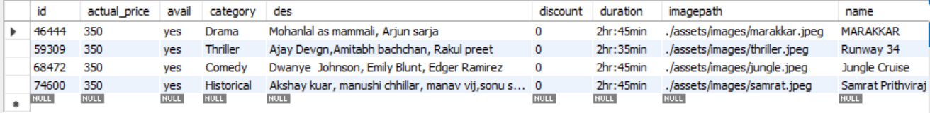
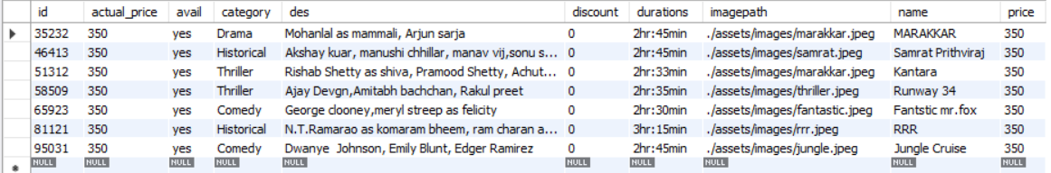
existing product table
after deleting a movie from table
after adding a movie
Add/Delete Movies MySQL Structure

Slide 13
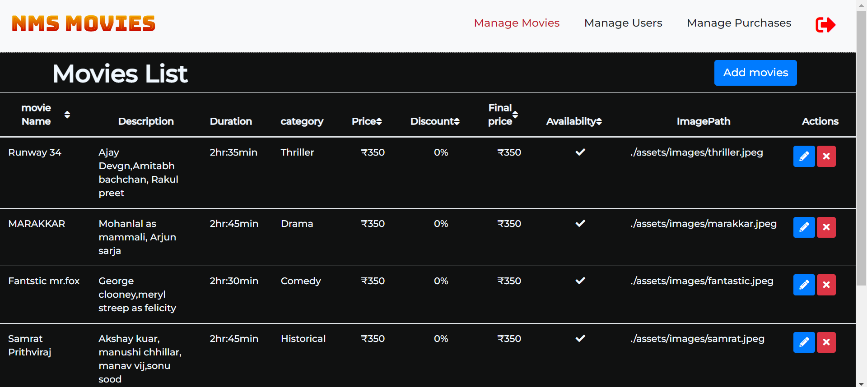
View Movies

Slide 14
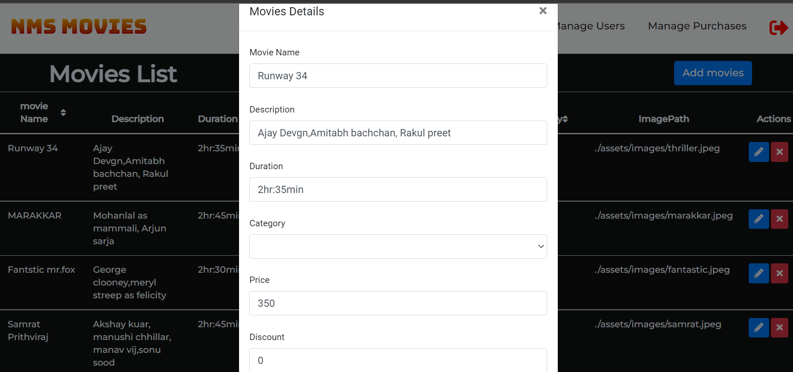
Update Movies

Slide 15
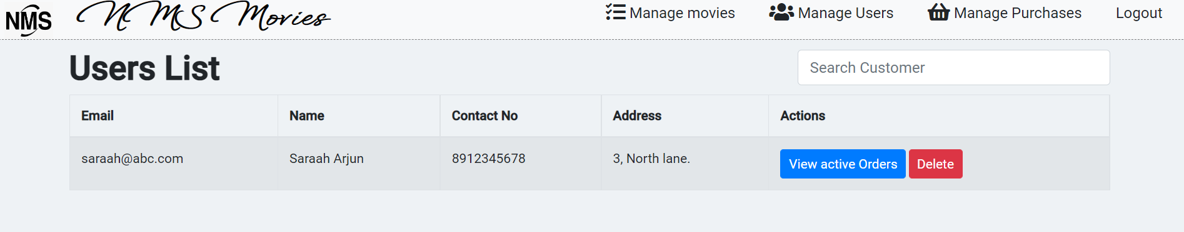
Manage Users By Admin
There are two buttons given in that page one for viewing the customer orders for booking movie and another button for deleting the customer
if there is no movie booking orders available.

Slide 16
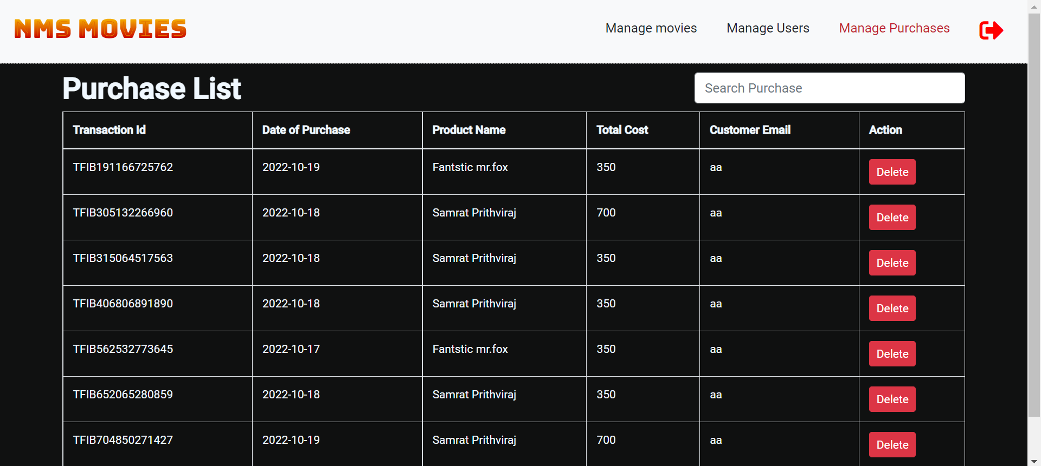
Manage Purchases

Slide 17
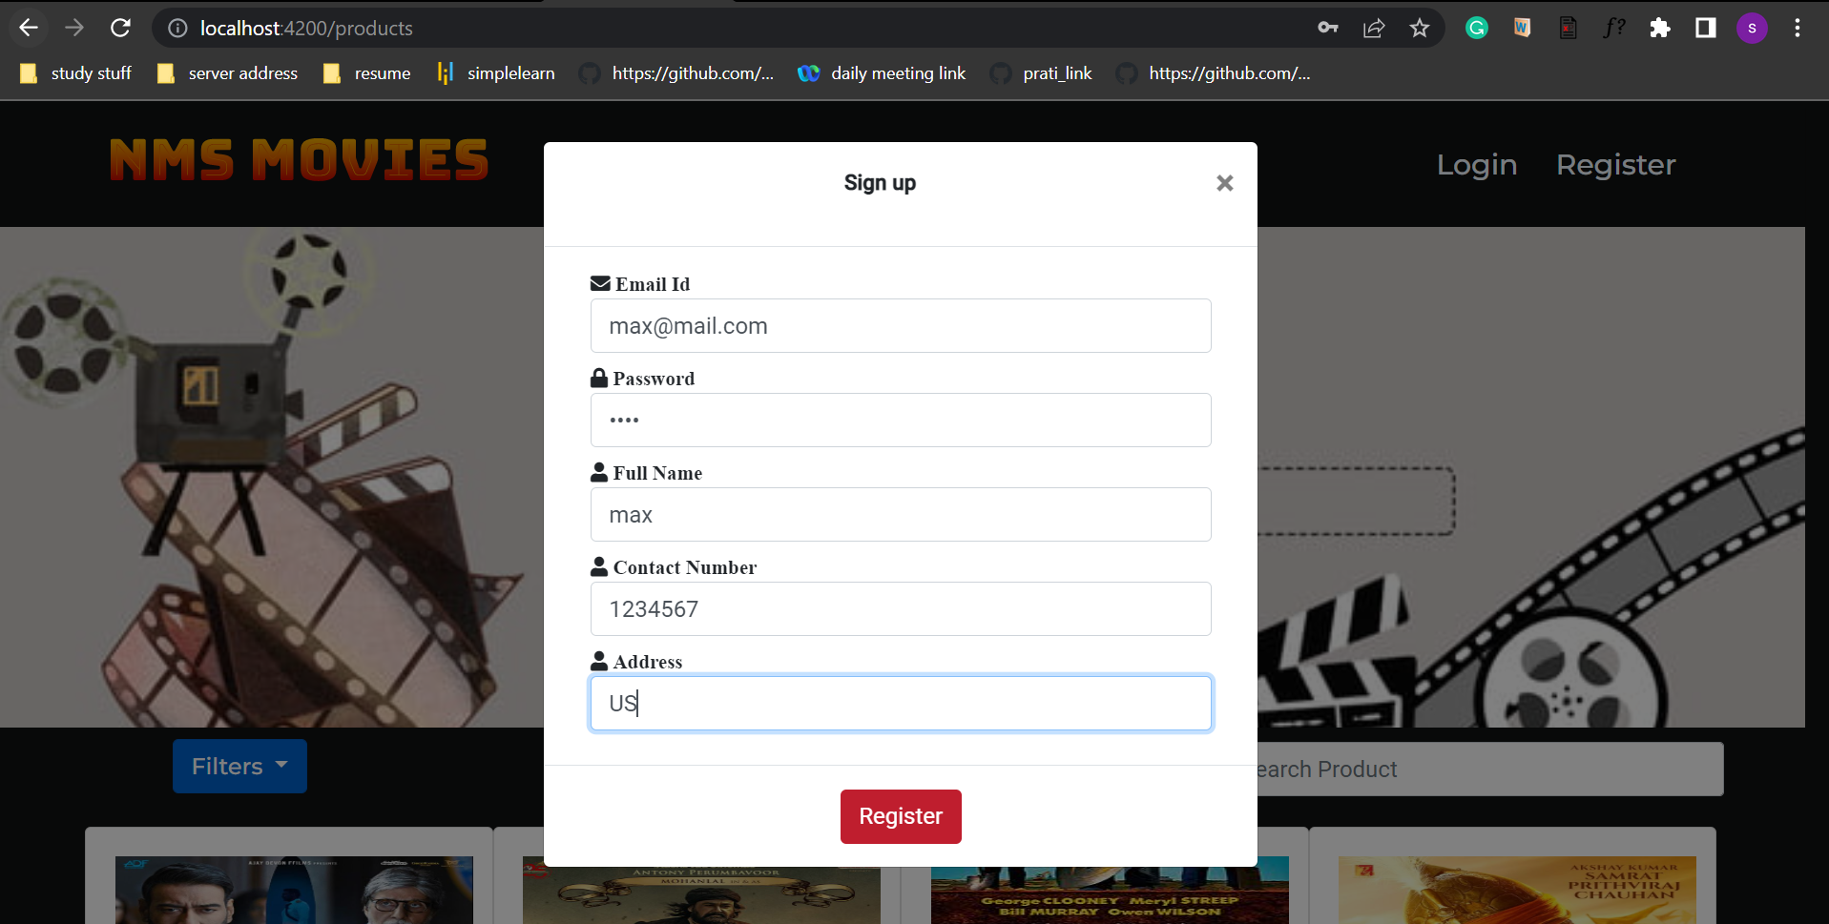
User Registration

Slide 18
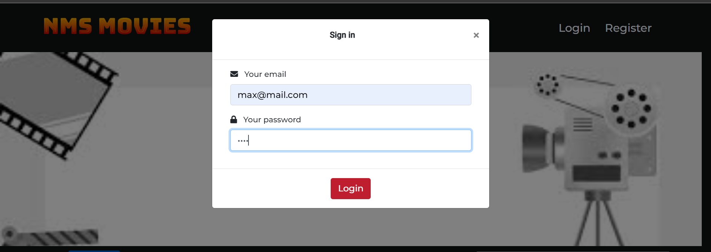
User Login

Slide 19
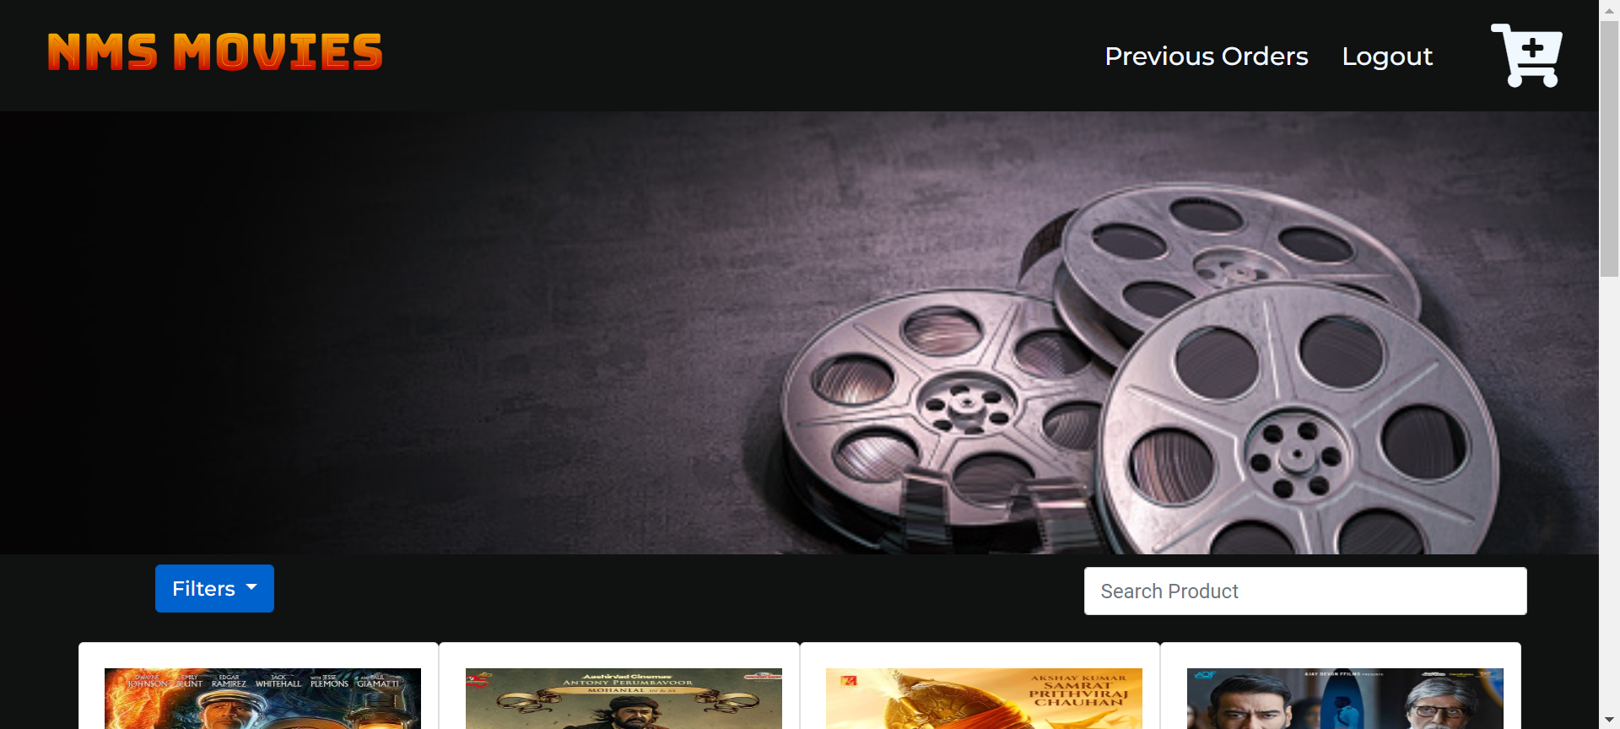
User Dashboard

Slide 20
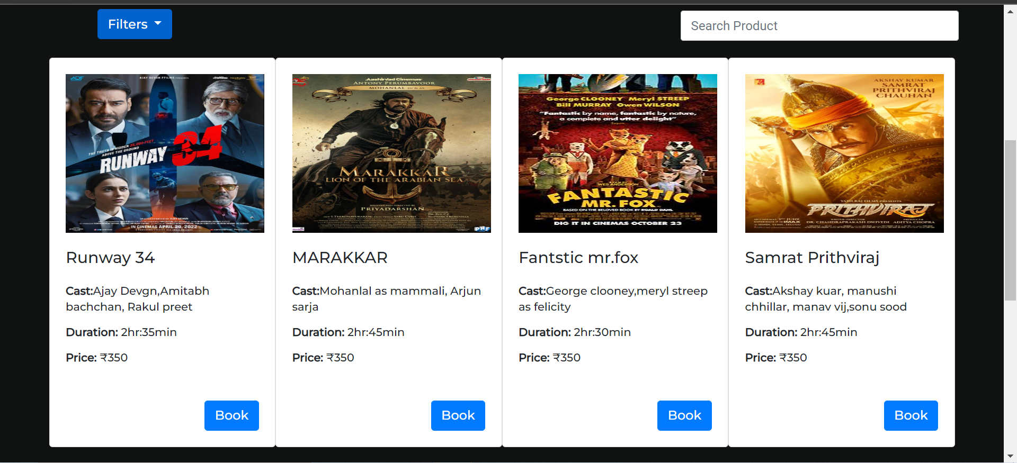
User Dashboard

Slide 21
Search Movies

Slide 22
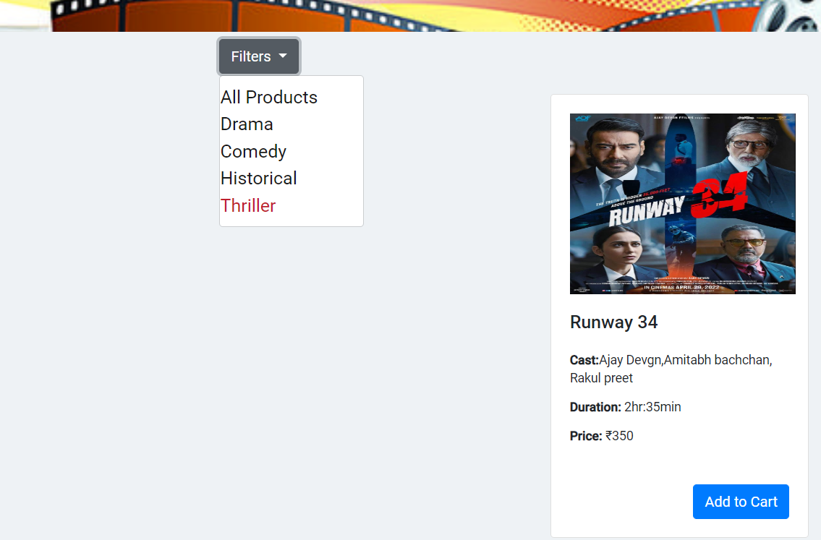
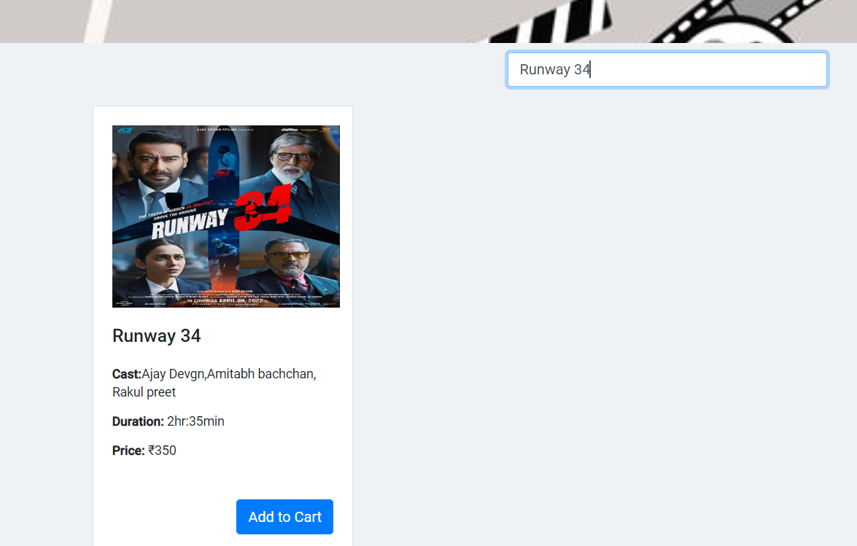
Thriller Movie
Searched Movie

Slide 23
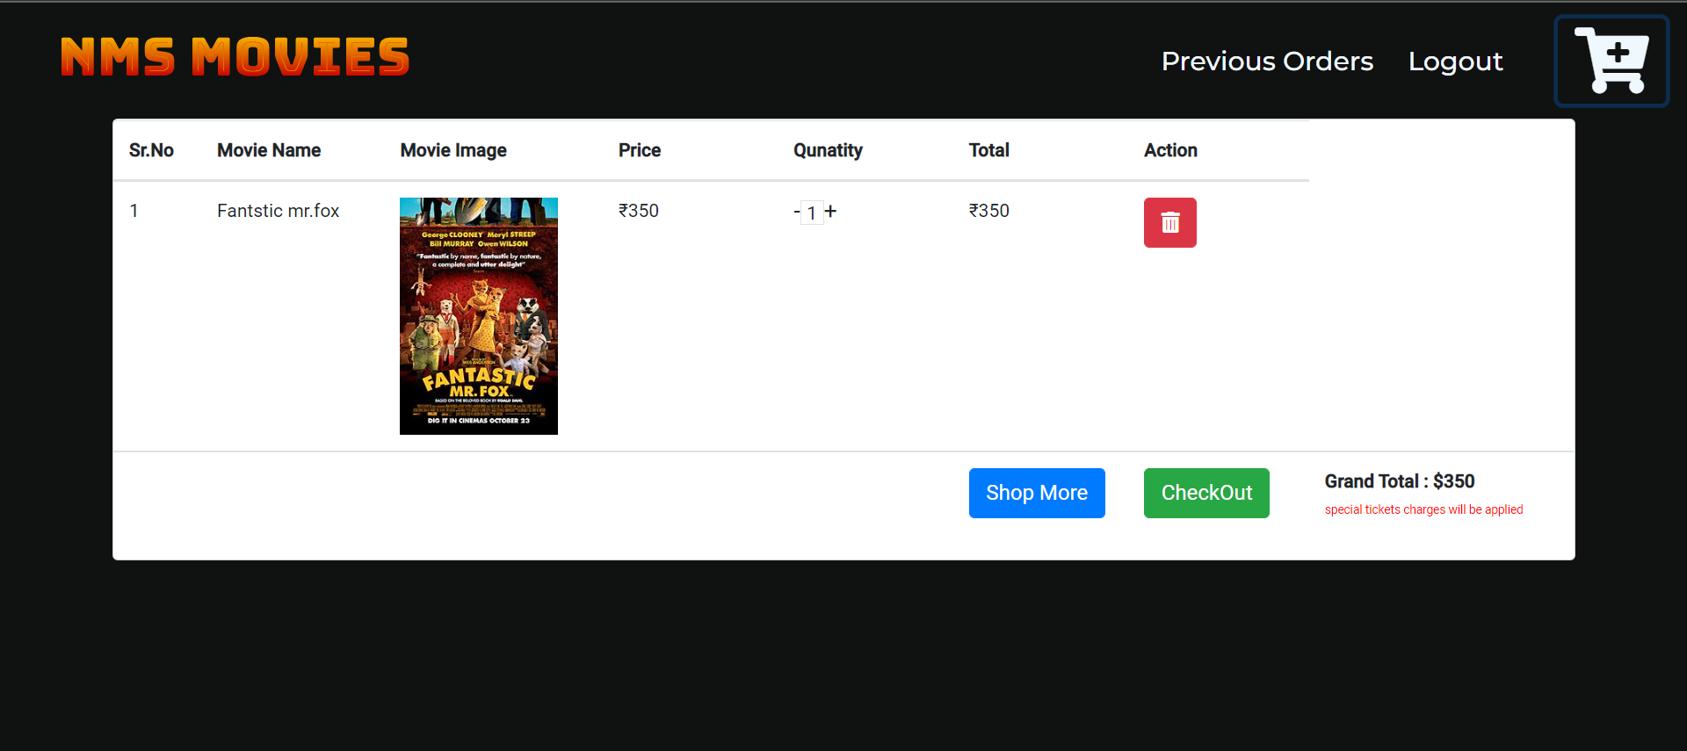
Add To Cart

Slide 24
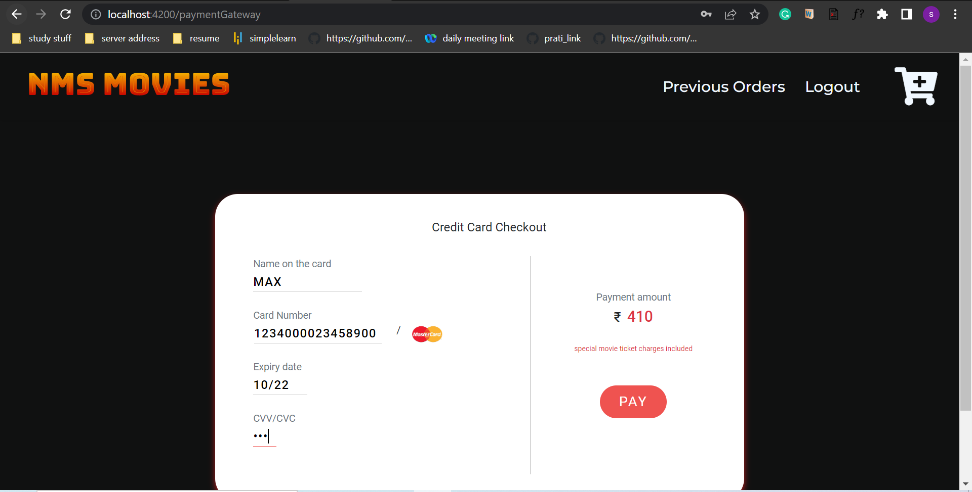
Payment Gateway

Slide 25
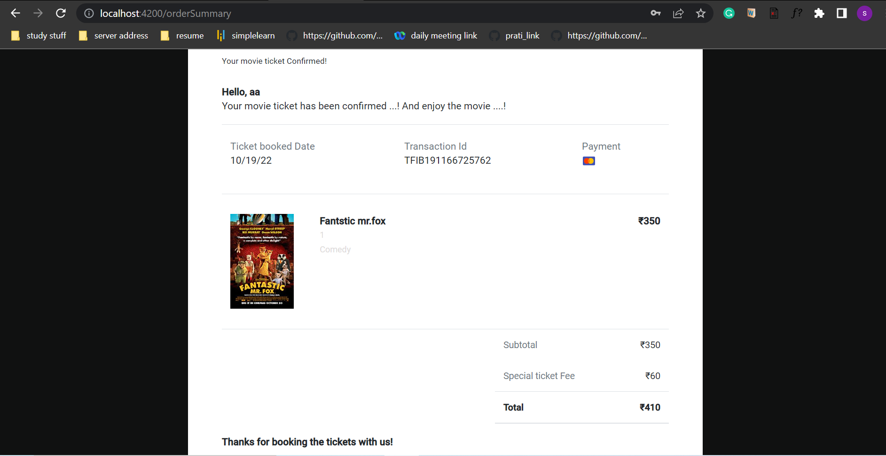
Order Summary

Slide 26
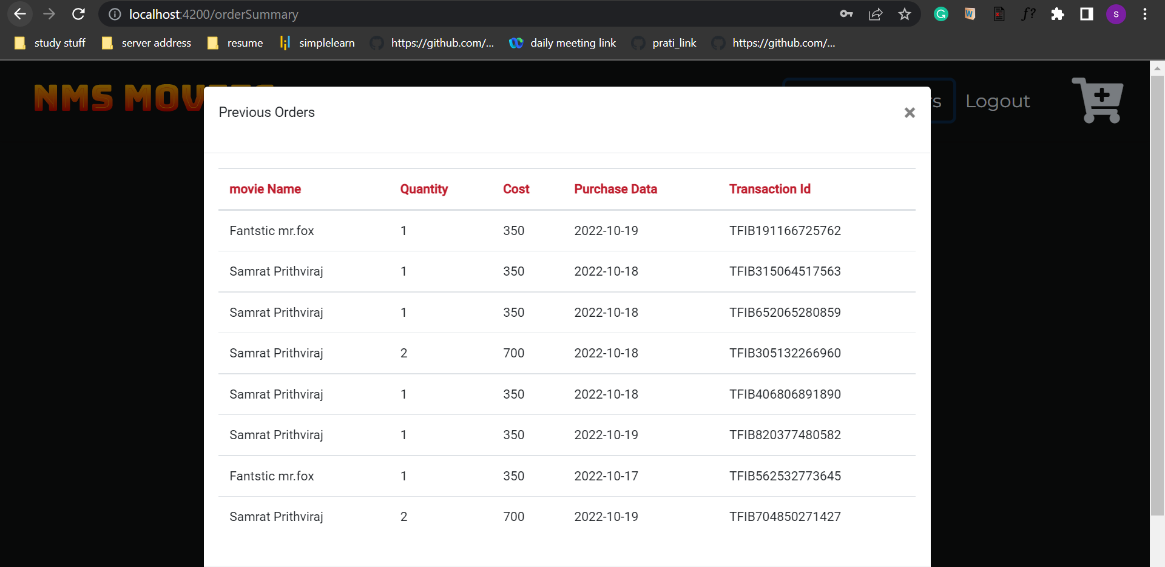
Previous Orders

Slide 27
Testing
API Testing Using Postman
Unit Testing using Selenium

Slide 28
Conclusion
ONLINE MOVIE TICKET BOOKING is the ticket booking service that allows the customers to book the movie tickets on the computerized networks such as internet through secure website with a particular movie booking system, which has resulted from the blossoming Internet technology, obviously has many benefits for the user by getting the entertainment without wasting the time by standing in queue for hours and hours.

Slide 29


